Slide 1


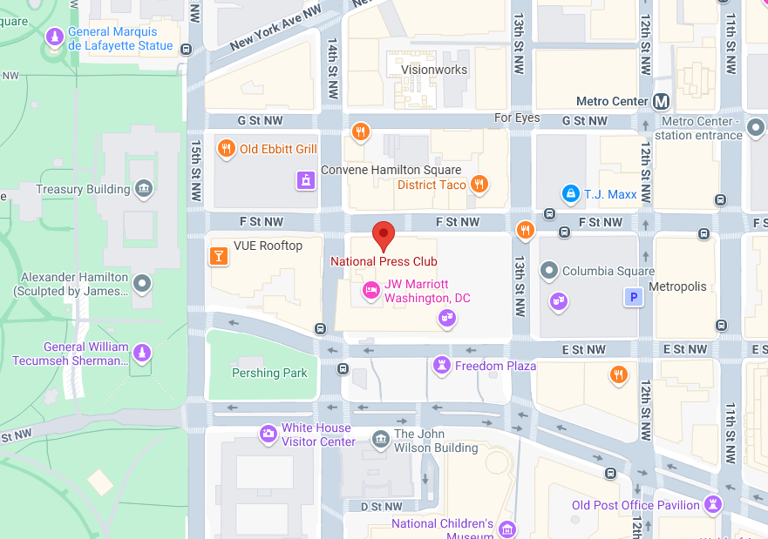
NIEMOpen Leadership Meeting National Press Club & Virtual
Date/time: 8 October 2025, ~ 9 AM – 4 PM
Venue: National Press Club & Virtual
529 14th St NW, Washington, DC 20045
“DRAFT” Agenda
Link for NBAC & NTAC Plenary Sessions: TBD
Link for AM & PM Joint Sessions & Q&A:
OASIS NIEM is inviting you to a scheduled Zoom meeting. Join Zoom Meeting https://us06web.zoom.us/j/8016452879?pwd=a3hNN0dieVJPR1pZY2QwbHVXbFJTUT09&omn=86251094933 Meeting ID: 801 645 2879 Passcode: 676136 One tap mobile +13052241968,,8016452879#,,,,*676136# US +13092053325,,8016452879#,,,,*676136# US
Supporting documents: https://github.com/niemopen/nbac-admin/tree/main/8-october-co-chair-meeting-npc

